Slide 1

Creating J.A.R.V.I.S.

Slide 2
Creating J.A.R.V.I.S.
An Awesome Guide To Automating Your Home
By Scott Preston

Slide 3
About Me
Live in Columbus, Ohio.
Been doing robotics for last 15 years
Wrote a few books on robotics and mobile/js/html5.
Practice Lead at ICC focusing on JavaScript
I’ll be at ICC booth after this talk pairing with JR.
First brought my robot to CodeMash in 2009.

Slide 4
What’s J.A.R.V.I.S. stand for?

Slide 5
J.A.R.V.I.S.
J – Just
A – A
R – Rather
V – Very
I – Intelligent
S - System

Slide 6
About J.A.R.V.I.S.
Ubuntu Server 12.04
Core i5 / 16GB Ram / 240GB SSD
1GB Ethernet / 1 Bluetooth
4 USB Serial Ports
4 Slave Raspberry PIs w/LIRC & Temp Sensors
9 Network Cameras
1 Windows Machine for Skype
@jarvispreston (Twitter Handle)

Slide 7
How did I get here?

Slide 8

Summer 2008

Slide 9
Initial Goals
Turn lights on/off Sunrise / Sunset
Wake me up with weather report

Slide 10
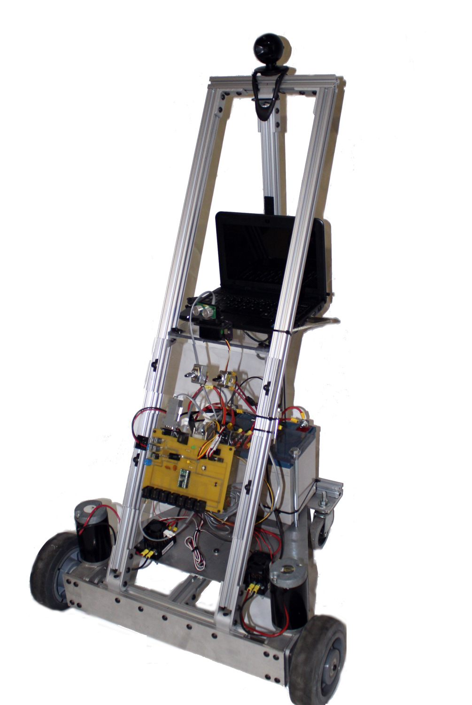
I had an old robot (JR-MK2)

Slide 11
Robot Had 2 Parts I needed
Basic Stamp & Distribution Board
Serial Servo Controller

Slide 12
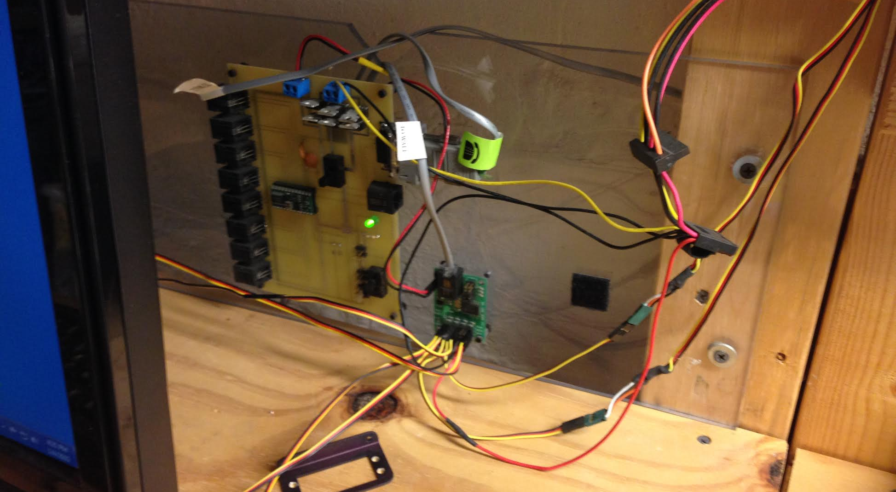
Stamp & Controller Board

Slide 13
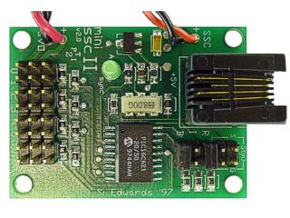
SSC

Slide 14
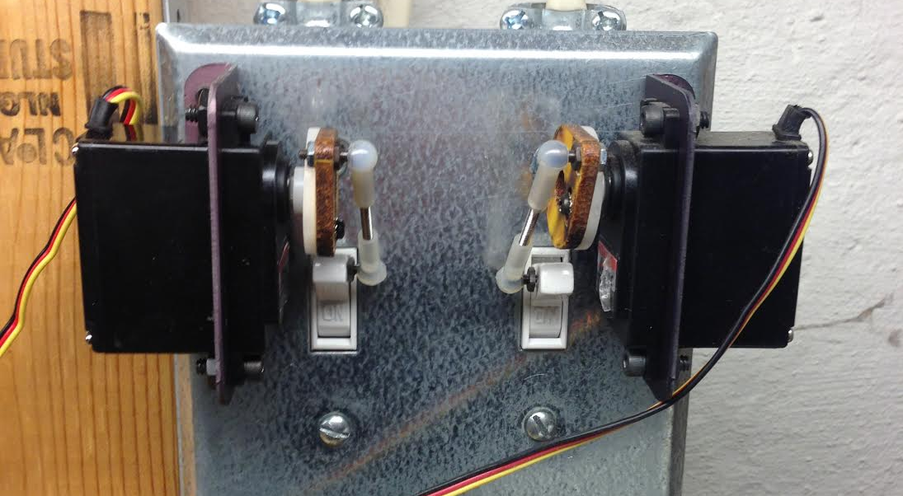
Before X10 ~ $7 Switch

Slide 15
Used SSC (Still Used)
Lights On
http://192.168.1.60:8001/?pin=2&pos=200
http://192.168.1.60:8001/?pin=3&pos=70
Lights Off
http://192.168.1.60:8001/?pin=2&pos=127
http://192.168.1.60:8001/?pin=3&pos=127

Slide 16
X10 – External Lights

Slide 17
What’s X10?
Developed in 1975 by Pico Electronics (Scotland)
Digital Carrier transmitted onto a 120hz carrier existing power lines.
Limitations – GCFI Outlets, Older Technology, Reliability, # of Devices
Pros – Cheap, Nothing else around in 2008, Microcontrollers have built-in support

Slide 18
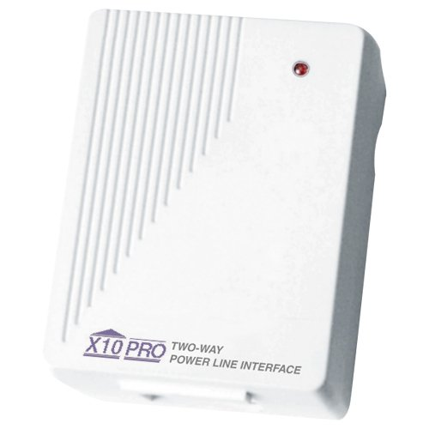
X10 – TW523 Interface~$60-$80

Slide 19
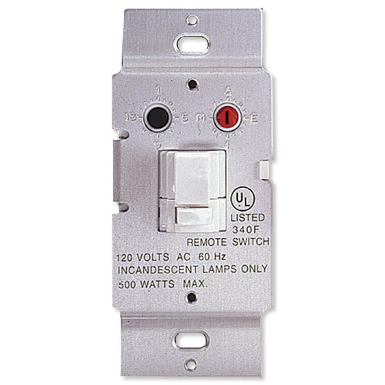
X10 – WS467 $16.99

Slide 20
X10 – Protocol (via BS2)
XOUT mPin, zPin, [houseCode\unitCode]
XOUT mPin, xPin, [houseCode\onORoff]
houseCode = 1-16
unitCode = 1-16
onORoff = 0, 1

Slide 21
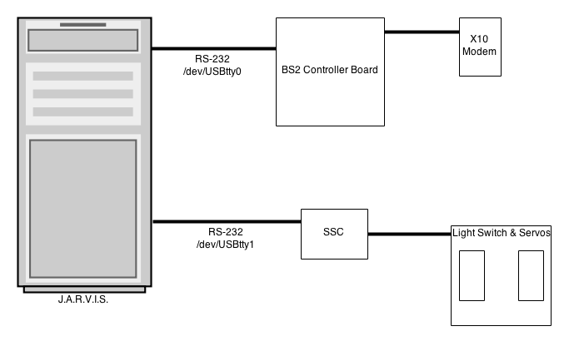
Initial Layout

Slide 22
Node Set-Up
npm install serial-port (Serial Ports)
npm install serial-servo (Serial Servo Controllers)

Slide 23
X10.js – SerialPort
var http = require('http');
var url = require('url');
var port = 8000;
var usbport = "/dev/ttyUSB0";
var SerialPort = require("serialport").SerialPort;
var sp = new SerialPort(usbport, {
baudrate: 9600
});
Serial Port Setup

Slide 24
X10.js – Server Code
var server = http.createServer(function (request, response) {
var url_parts = url.parse(request.url, true);
var house = url_parts.query.house;
var device = url_parts.query.device;
var onoff = url_parts.query.onoff;
write(house,device,onoff);
});
Http Parms to Serial Port

Slide 25
X10.js – Serial Writing
function write(house, device, onoff) {
if (house >= 0 && device >= 0 && onoff >= 0) {
var b = [100, house, device, onoff];
sp.write(b);
}
}
Byte[] sent to serial port

Slide 26
Sunrise & Sunset
http://api.wunderground.com/api/USER_KEY/astronomy/q/43212.json
Gets sun-rise
Gets sun-set
CRON runs each minute and checks for time match

Slide 27
Weather Underground – REST API
http://api.wunderground.com/api/USER_KEY/conditions/q/43212.json
Schedule Via CRON (hourly)
Populate to database via wrapper.

Slide 28
Putting It All Together
Old Robot Parts w/Serial & X10
X10 Switches
Weather Underground w/Sunrise & Sunset Data
CRON Scheduler
Results: Robot that can turn on/off lights for me.
Missing: Text-To-Speech (later)

Slide 29
More Devices
Since X10 is 40 years old

Slide 30
Kinds Of Devices (non-X10)
Proprietary (Lots of these) – On their own
Wifi – Many devices, limited APIs & Smart Phones
BLE – Blue Tooth Low Energy (Smart Phone Only)
Z-Wave – Need Interface (Wireless)
Insteon – Need Interface module Wireless + X10

Slide 31
Kinds Of Devices (non-X10)
Proprietary (Lots of these) – On their own
Wifi – Many devices, limited APIs & Smart Phones
BLE – Blue Tooth Low Energy (Smart Phone Only)
Z-Wave – Need Interface (Wireless)
Insteon – Need Interface module Wireless + X10

Slide 32
Kinds Of Devices (non-X10)
Proprietary (Lots of these) – On their own
Wifi – Many devices, limited APIs & Smart Phones
BLE – Blue Tooth Low Energy (Smart Phone Only)
Z-Wave – Need Interface (Wireless)
Insteon – Need Interface module Wireless + X10

Slide 33
Kinds Of Devices (non-X10)
Proprietary (Lots of these) – On their own
Wifi – Many devices, limited APIs & Smart Phones
BLE – Blue Tooth Low Energy (Smart Phone Only)
Z-Wave – Need Interface (Wireless)
Insteon – Need Interface module Wireless + X10

Slide 34
Device Types
Controllers
Locks
Thermostats
Sensors
Lights
Switches
Smart Meters

Slide 35
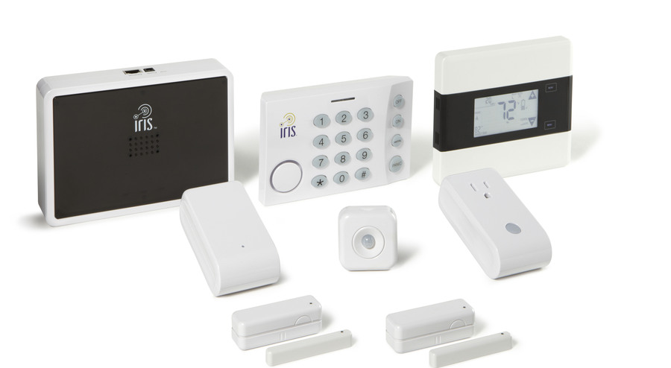
Proprietary - IRIS by Lowes
Some devices Z-Wave Compatible!

Slide 36
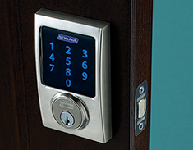
Schlage Z-wave Lock

Slide 37
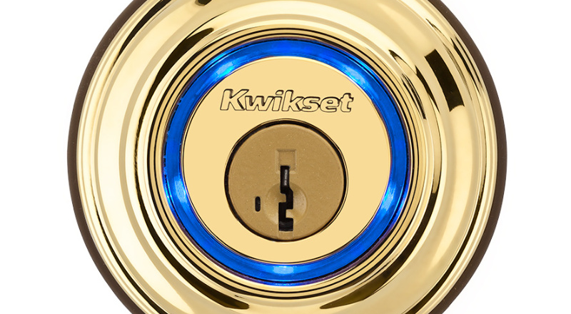
KEVO – Bluetooth LE (Not Z-Wave)

Slide 38
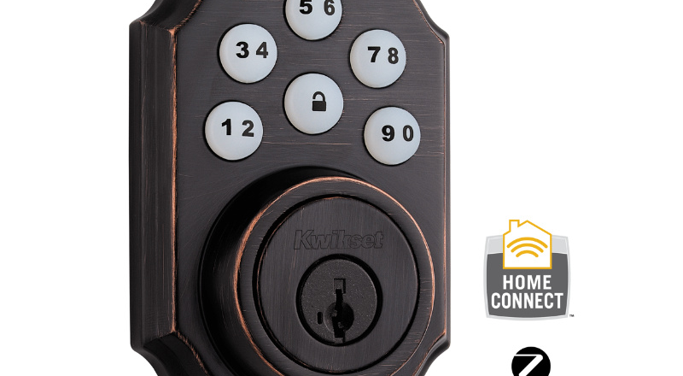
Kwickset – Z-Wave

Slide 39
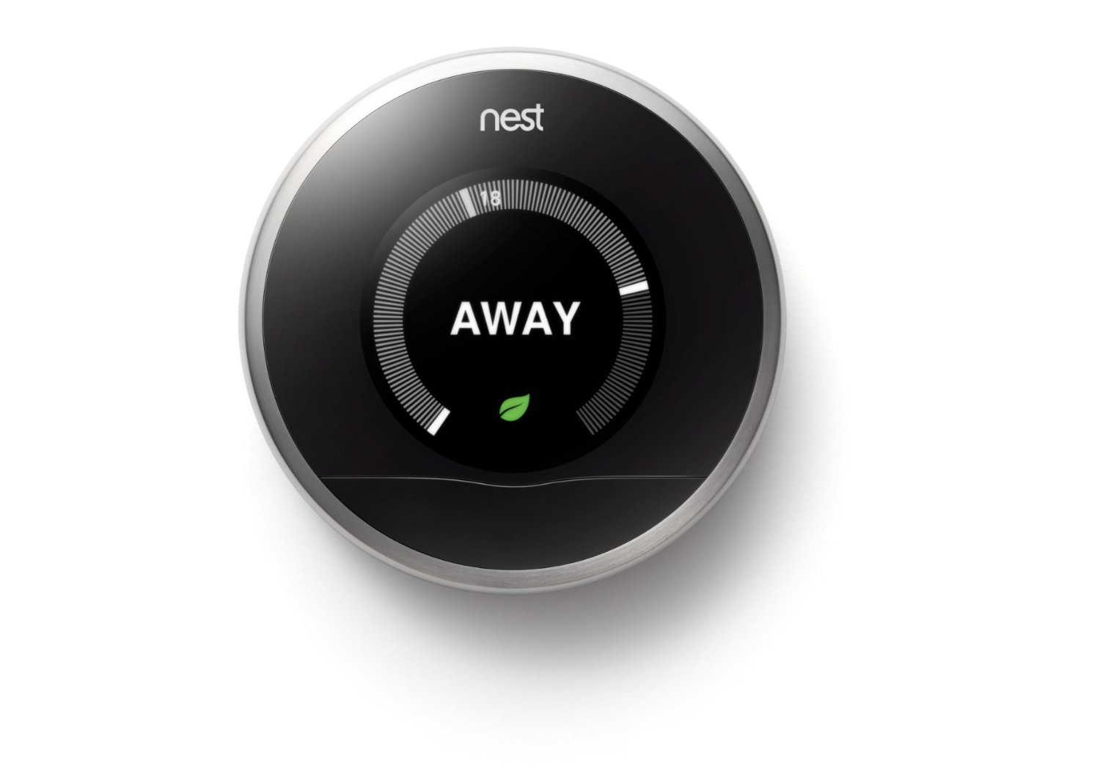
nest Thermostat ($250)
REST API available from nest and full SDK.

Slide 40
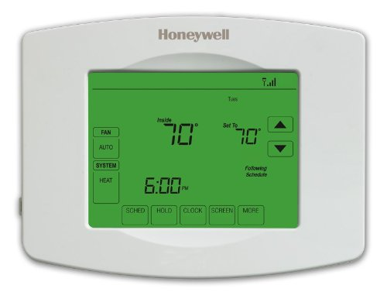
Z-Wave + WiFi ~$75 to $200

Slide 41
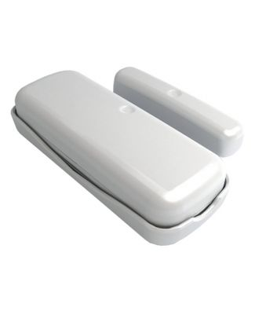
Aeon Labs – Z-Wave Switch

Slide 42
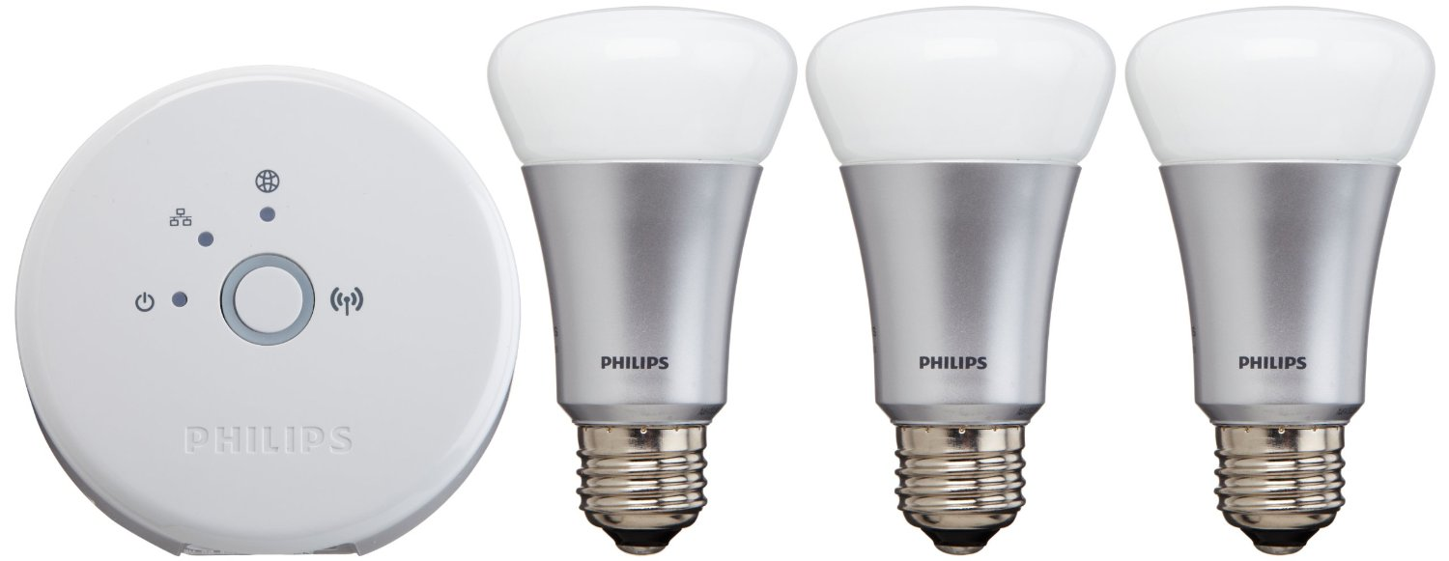
Phillips Hue (Zigbee & Ethernet)
http://www.developers.meethue.com/tools-and-sdks

Slide 43
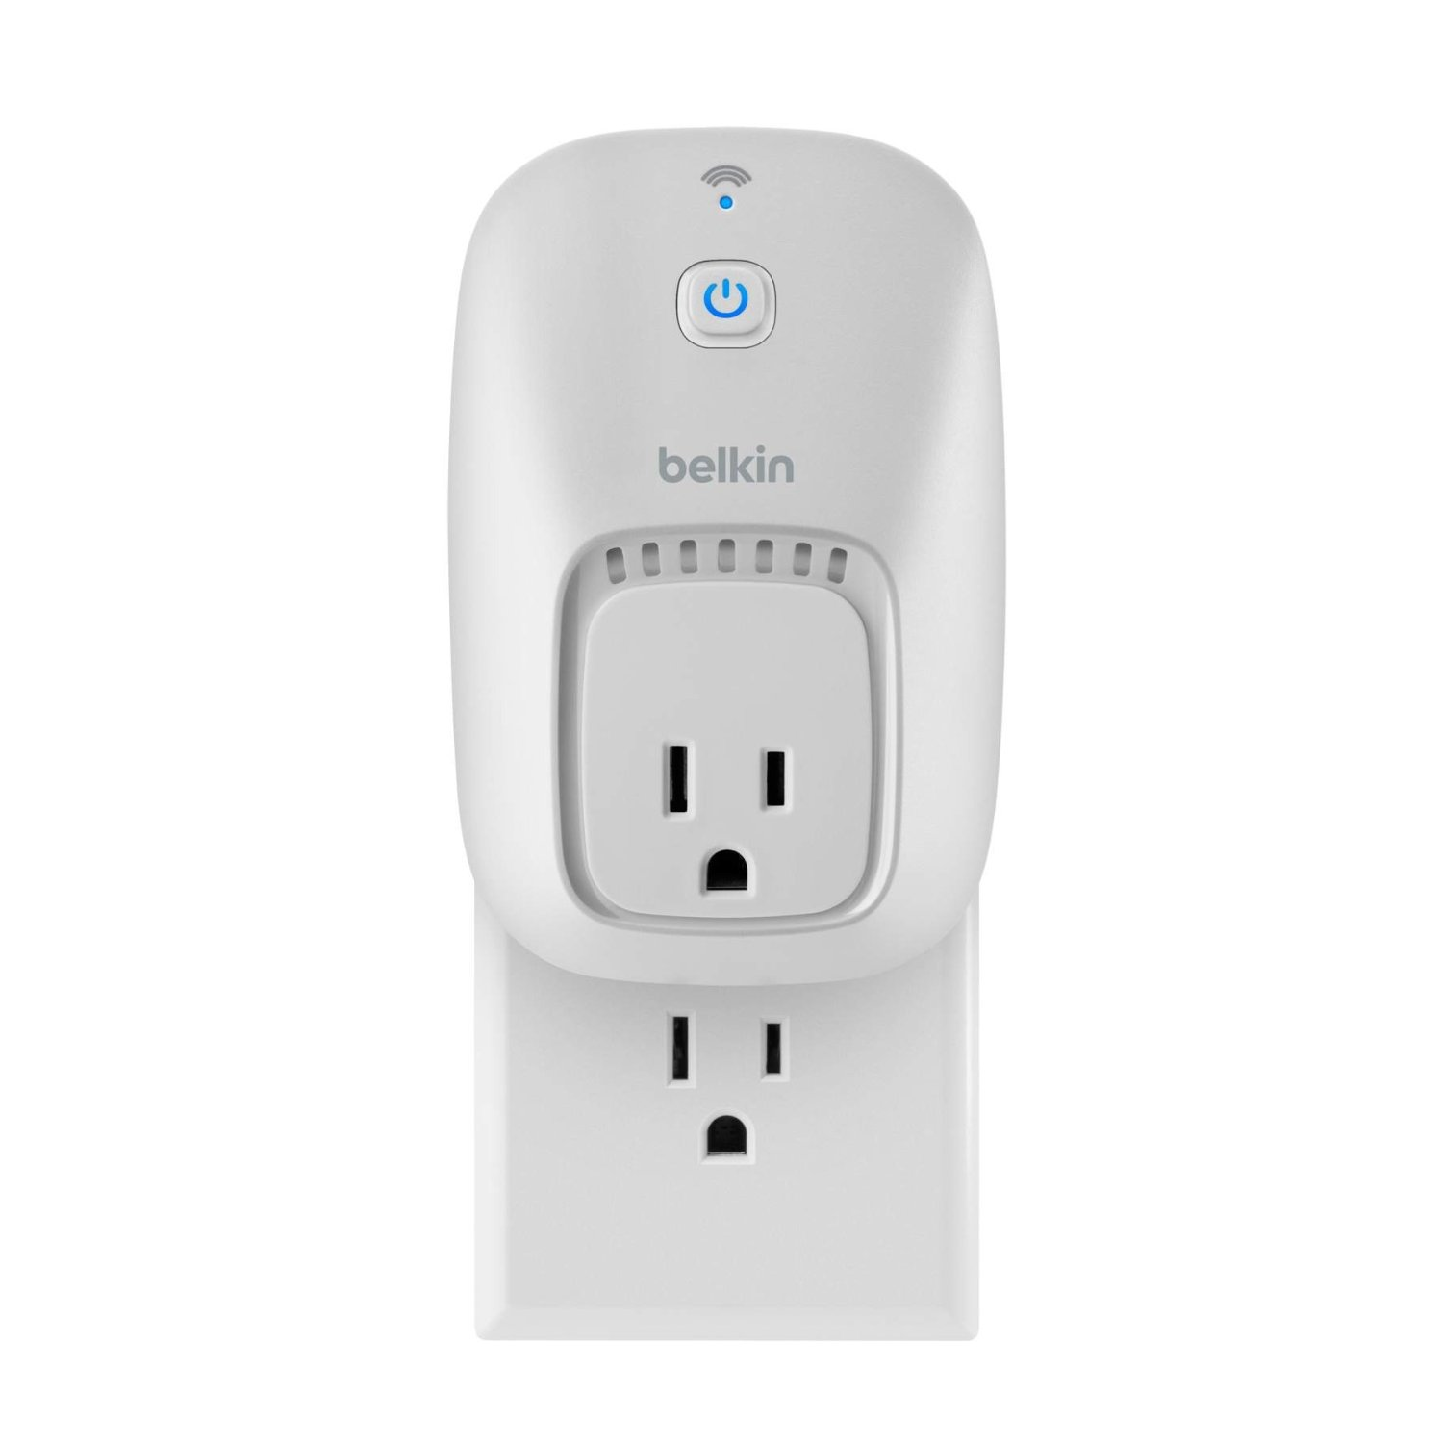
WeMo – WiFi Switch
Many NPM modules available to use.

Slide 44
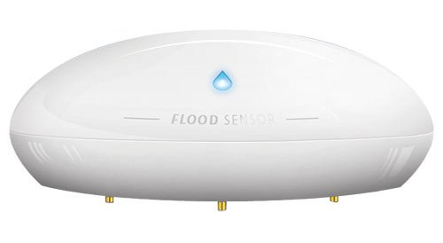
Z-Wave Flood Sensor

Slide 45
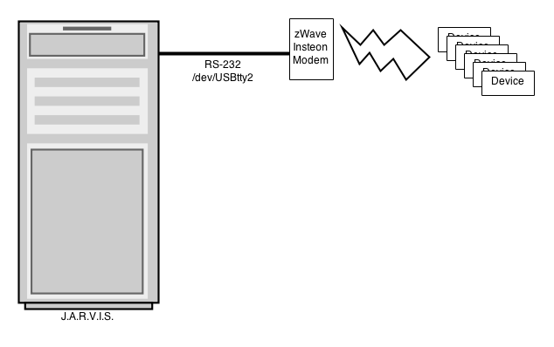
Z-wave Interfacing

Slide 46
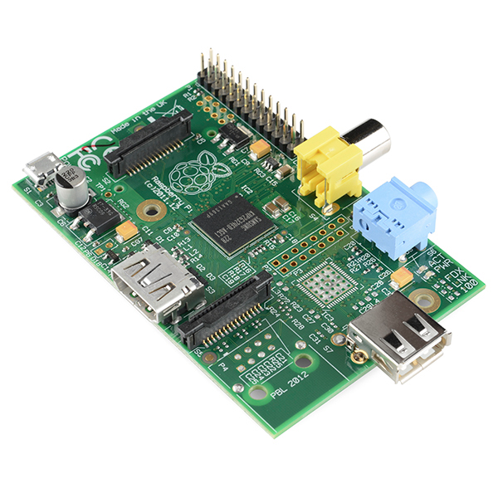
Raspberry Pi ~ $30

Slide 47
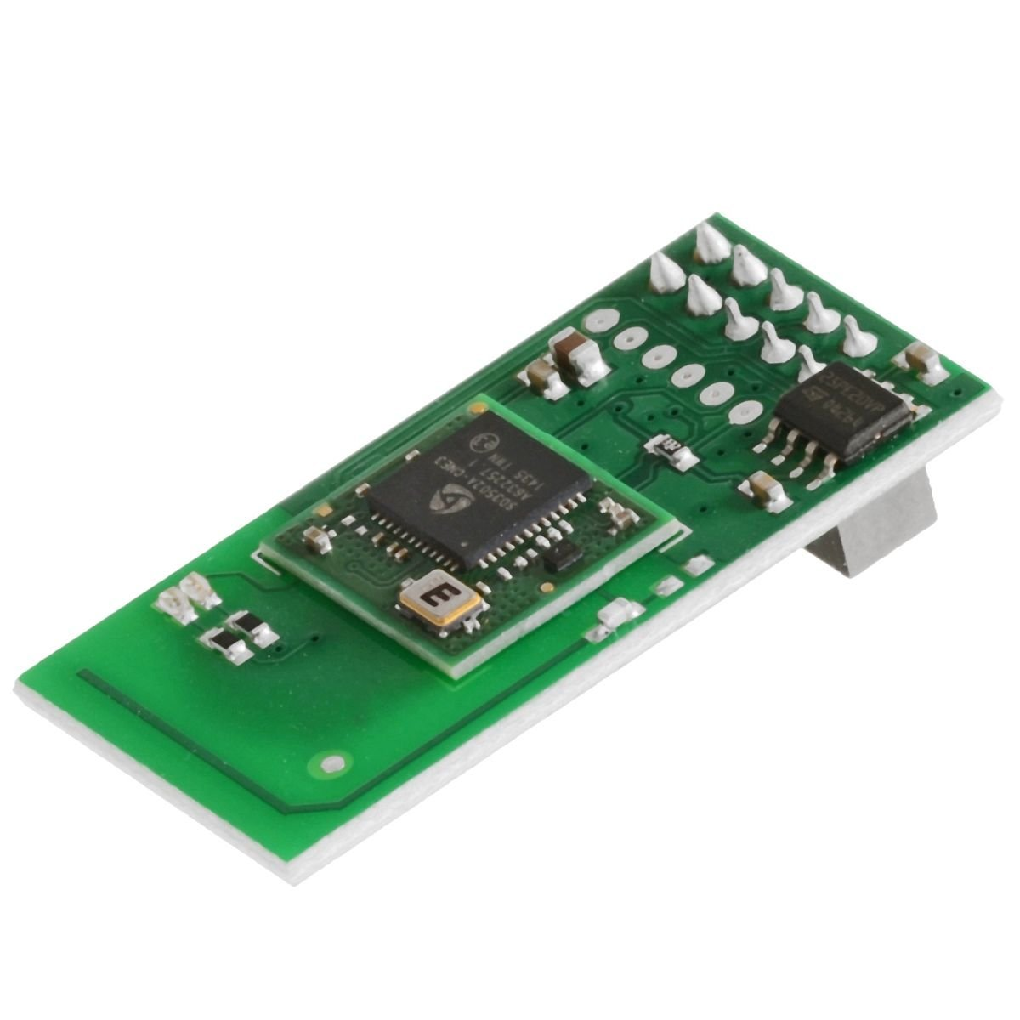
Z-Wave GPIO Daughter Card - $60
http://razberry.z-wave.me/

Slide 48
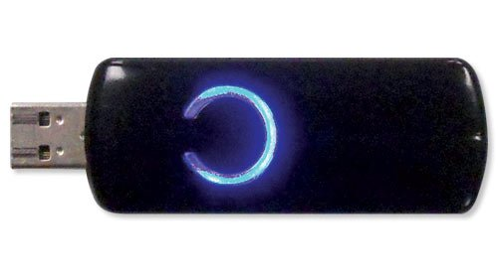
Z-Wave USB ~$40
Google ‘openzwave’ for npm modules.

Slide 49
How close are we to J.A.R.V.I.S.?

Slide 50
J.A.R.V.I.S.
Home Sensors
Home Control (Lights/Blinds/Etc.)
Speech Recognition / Text-To-Speech
Computer Vision
TV / Stereo Control
Event Based System & Robot Control
3D Metal Printers

Slide 51
Speech Recognition
w/Sphinx4
Open Source Java Speech Recognition

Slide 52

Wrote this book in 2005.

Slide 53
SR – Part 1 (Chapter 6)
Gets “best” result
while (true) { Result result = recognizer.recognize(); if (result != null) { String resultText = result.getBestFinalResultNoFiller(); JarvisUtils.logger("I heard: " + resultText); String recognizerURL = "http://192.168.1.60/voice/respond/"; ApacheHttp.postSingleString(recognizerURL,"txt",resultText); JarvisUtils.pause(2000); // wait a second before listening again } }

Slide 54
SR – Part 1 (Chapter 6)
while (true) { Result result = recognizer.recognize(); if (result != null) { String resultText = result.getBestFinalResultNoFiller(); JarvisUtils.logger("I heard: " + resultText); String recognizerURL = "http://192.168.1.60/voice/respond/"; ApacheHttp.postSingleString(recognizerURL,"txt",resultText); JarvisUtils.pause(2000); // wait a second before listening again } }
Passes to service for response & TTS

Slide 55
Before 2014
Each Call To Specific Words → Map to specific URLs
Each time I wanted to update, I had to re-compile, and updated.
I wanted something more dynamic.
if command1, call service1, if command2, call service2

Slide 56
Early 2014
Sent words to service.
Service mapped words to new service endpoints.

Slide 57
Late 2014
Changed from service mappings to event publish via RabbitMQ

Slide 58
Text To Speech
3rd Party Voice (Cepstral TTS)
Festival TTS (Free)
Linux command I’m using:
/usr/bin/padsp swift “words to speak”

Slide 59
Remote Text To Speech
swift "$1" -o tmp.wav // create wav
lame tmp.wav tmp.mp3 // convert to mp3
scp tmp.mp3 pi@10.10.10.32:tmp.mp3 // send
ssh pi@10.10.10.32 'mpg123 tmp.mp3' // play

Slide 60
Remote Text To Speech
swift "$1" -o tmp.wav // create wav
lame tmp.wav tmp.mp3 // convert to mp3
scp tmp.mp3 pi@10.10.10.32:tmp.mp3 // send
ssh pi@10.10.10.32 'mpg123 tmp.mp3' // play

Slide 61
Remote Text To Speech
swift "$1" -o tmp.wav // create wav
lame tmp.wav tmp.mp3 // convert to mp3
scp tmp.mp3 pi@10.10.10.32:tmp.mp3 // send
ssh pi@10.10.10.32 'mpg123 tmp.mp3' // play

Slide 62
Remote Text To Speech
swift "$1" -o tmp.wav // create wav
lame tmp.wav tmp.mp3 // convert to mp3
scp tmp.mp3 pi@10.10.10.32:tmp.mp3 // send
ssh pi@10.10.10.32 'mpg123 tmp.mp3' // play

Slide 63
How do I talk to J.A.R.V.I.S.?
Microphone
Wireless Headset
Bluetooth
Skype via API?
Skype as Services??

Slide 64
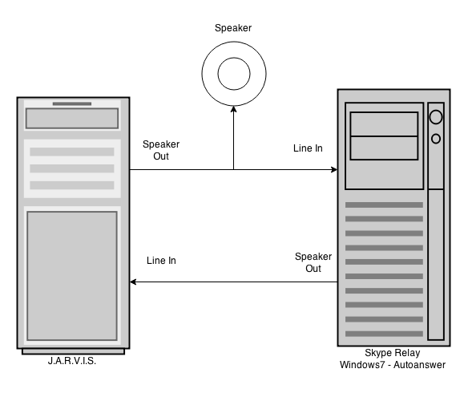
Skype As Service (low-tech)

Slide 65
Putting It all Together
Speech Recognition – Publishing Events
Text To Speech either via Speaker, Skype (Phone) or Remote Speaker
Tell J.A.R.V.I.S. to turn on lights and turn off lights

Slide 66
J.A.R.V.I.S Voice Demo

Slide 67
What Next?

Slide 68
Computer Vision
9 Network Cameras in Total
To Report Motion Detection Events
Each capable of doing face recognition (still debugging)
J.A.R.V.I.S. – Using Java based motion detection in multiple threads for each camera defined via UI
Table of Camera Stored in J.A.R.V.I.S Database

Slide 69
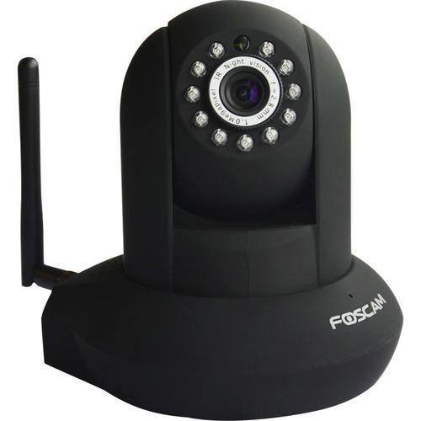
Foscam Pan/Tilt
Resolution 640x480 and 1280x720

Slide 70
Camera Parameters
Name
Snapshot_url for taking JPG image
Sample Frequency in milliseconds
Sensitivity
Top, Left, Height, Width
Notify URL / Event To Publish

Slide 71
Vision Summary
9 Cams Mapped To Location
J.A.R.V.I.S. monitors “motion” events and “face” events
Checks For Motion every 500ms to 2000ms
Face checks only if motion

Slide 72
TV / Stereo Control
Device Might Have an API
LIRC w/Raspberry PI

Slide 73
DirecTV - Power On
http://192.168.1.99:8080/remote/processKey?key=poweron&hold=keyPress

Slide 74
DirecTV – Power Off
http://192.168.1.99:8080/remote/processKey?key=poweroff&hold=keyPress

Slide 75
DirecTV – Change Channel
http://192.168.1.99:8080/tv/tune?major=10

Slide 76
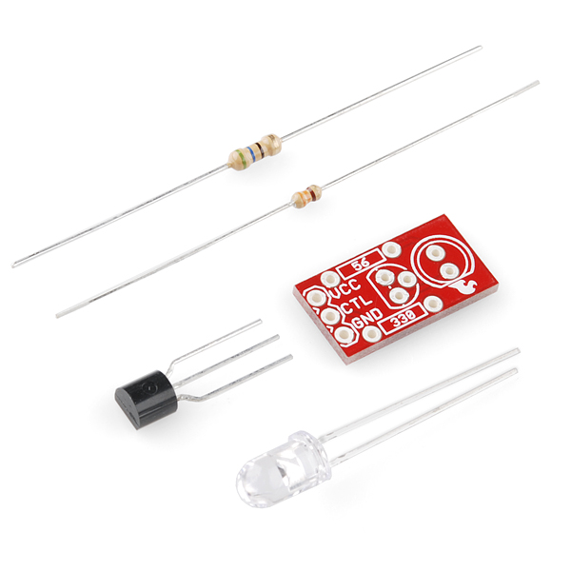
Sparkfun – Max Power LED $2.95

Slide 77
LIRC
Linux Infrared Remote Control - http://www.lirc.org/
apt-get install lirc
update /etc/modules
update /etc/lirc/hardware.conf
update /etc/lirc/lircd.conf

Slide 78
Invoking From Service
Use php exec(garage-power.sh)
#!/bin/bash ssh pi@10.10.10.32 'irsend SEND_ONCE yam POWER'
** Subscribe to STEREO_ON event, calls shell

Slide 79
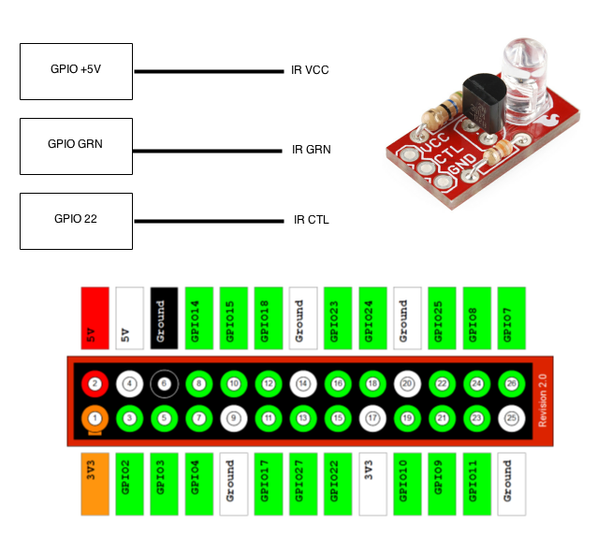
LIRC Diagram
Raspberry PI GPIO

Slide 80
lircd.conf
begin remote
name yam
bits 32
flags SPACE_ENC
eps 20
aeps 200
header 8800 4400
one 550 1650
zero 550 550
ptrail 550
repeat 8800 2200
gap 38500
toggle_bit 0
frequency 38000
begin codes
POWER 0x000000005EA1F807

Slide 81
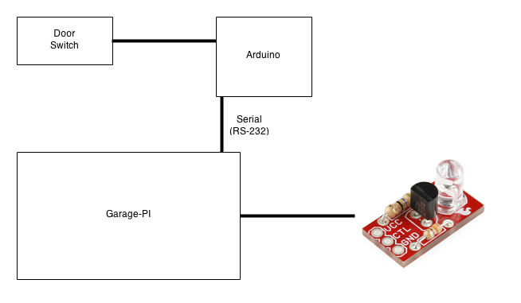
Garage Wiring Diagram

Slide 82
Garage Behavior
PUBLISHERS (garage-pi)
If (open) publish (‘garage-door-open’)
CONSUMERS (garage-pi, jarvis, feynman)
turn on PC
greet via tts
turn on garage lights,
turn on garage TV or Stereo (different rules)

Slide 83
Final Step
Event Based Architecture

Slide 84
Why Events?
Everything that’s happening is some kind of event.
Multiple subscribers to events - jarvis, tvroom-pi, garage-pi, basement-pi, feynman-jr, feynman (in garage)
One places to control event processing vs. in each app

Slide 85
Before Events
Speech Recognition – Mapped to services, words were hard coded, each update required new java compile.
Hard coded URLS everywhere – 4 Pis, new functionality, required going everywhere and updating service definition.
Chains of Services (IF-THIS-THEN-THAT) IFTTT required going lots of places

Slide 86

NodeJS Installation
npm install amqp

Slide 87

RabbitMQ - Installation
apt-get install rabbitmq-server

Slide 88
Dynamically Load Event Rules
{ "name": "test", "events": [ { "name": "broadcast", "data": { "endpoints": [ "http://www.google.com", "http://www.scottpreston.com"] } }, { "name": "notify", "data": { "message": "tested google and scottpreston" } } ]}

Slide 89
Dynamically Load Event Rules
Event Name
(What’s Published)
{ "name": "test", "events": [ { "name": "broadcast", "data": { "endpoints": [ "http://www.google.com", "http://www.scottpreston.com"] } }, { "name": "notify", "data": { "message": "tested google and scottpreston" } } ]}

Slide 90
Dynamically Load Event Rules
{ "name": "test", "events": [ { "name": "broadcast", "data": { "endpoints": [ "http://www.google.com", "http://www.scottpreston.com"] } }, { "name": "notify", "data": { "message": "tested google and scottpreston" } } ]}
Event Type

Slide 91
Dynamically Load Event Rules
{ "name": "test", "events": [ { "name": "broadcast", "data": { "endpoints": [ "http://www.google.com", "http://www.scottpreston.com"] } }, { "name": "notify", "data": { "message": "tested google and scottpreston" } } ]}
Event Data

Slide 92
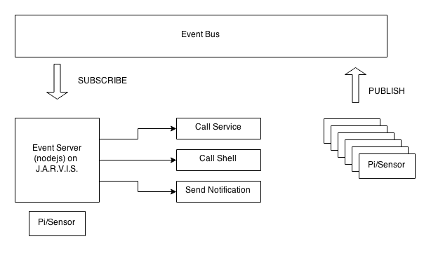
Putting It All Together

Slide 93
Event-server.js
Create Connection
function createConnection() { var connection = amqp.createConnection({host: 'localhost'}); connection.on('ready', function () { connection.exchange('house', { type: 'fanout', autoDelete: false }, function (exchange) { connection.queue('tmp-' + Math.random(), {exclusive: true}, function (queue) { queue.bind('house', ''); console.log(' [*] Waiting for house events. To exit press CTRL+C') queue.subscribe(function (msg) { var message = msg.data.toString('utf-8'); console.log("message received = " + message); var eventDetail = JSON.parse(message); processEvent(eventDetail.name, eventDetail.data); }); }) }); }); }

Slide 94
Event-server.js
function createConnection() { var connection = amqp.createConnection({host: 'localhost'}); connection.on('ready', function () { connection.exchange('house', { type: 'fanout', autoDelete: false }, function (exchange) { connection.queue('tmp-' + Math.random(), {exclusive: true}, function (queue) { queue.bind('house', ''); console.log(' [*] Waiting for house events. To exit press CTRL+C') queue.subscribe(function (msg) { var message = msg.data.toString('utf-8'); console.log("message received = " + message); var eventDetail = JSON.parse(message); processEvent(eventDetail.name, eventDetail.data); }); }) }); }); }
Process Event

Slide 95
Event-server.js - Continued
handledEvents.broadcast = function (endpoint) { if (endpoint) { request(endpoint, function (error, response, body) { …
}); } };
Event Handler
(to make http call to service)

Slide 96
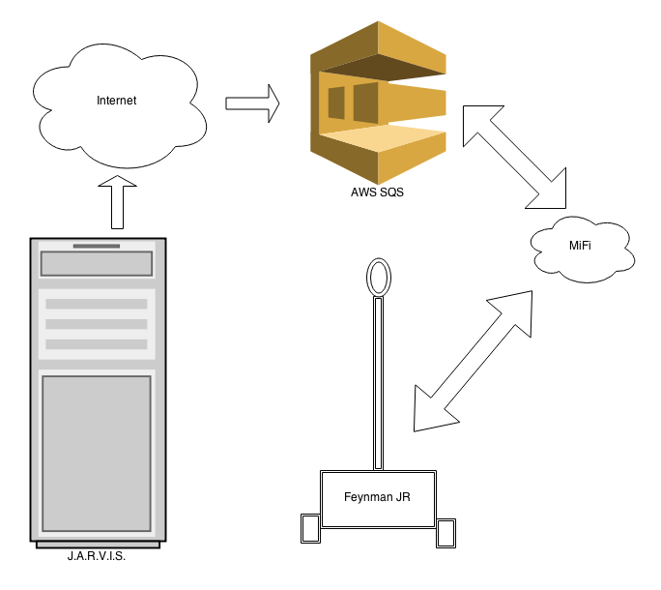
Non-Local Events - SQS

Slide 97
J.A.R.V.I.S & Feynman JR. DEMO

Slide 98
Thank You
@scottpreston
Http://github.com/scottpreston

